Slide 1

Mechanical Engineering Senior Design (ME490A) Team M9, Mean Green Growing Machine Project 18, Automated Microgreens PMP Briefing 9/28/20
John Berger, Max Merritt, Thuyavan Sathiamurthi, Conor Vasiliadis
Ali Alqaoud, Daniel Kenner, Jose Baez, Abigail Dabu, Elias Wooten

Slide 2
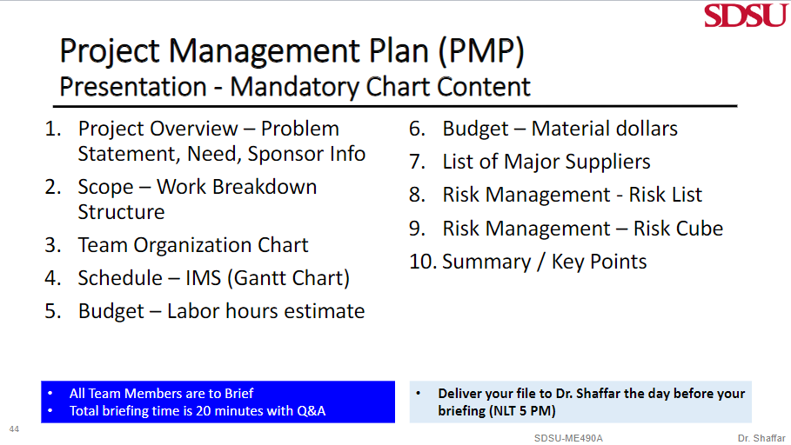
Slide Layout

Slide 3
Project Overview
Problem Statement:
There is an increasing demand for microgreens due to the higher concentration of nutrient contents. However, with microgreens being a relatively new industry, consumers can find it difficult to find markets that sell the product. Where microgreens are found, they are usually priced at a premium due to the nutritional content and niche appeal of the product.
Need:
To design and analyze an automated growing environment, which will allow consumers to produce microgreens at home. To accomplish this, we will need to research the microgreen growing process. System functionality will need to be tested and tuned for optimal plant mass output and growth period. The overall design will have to be optimized to be economically viable as a consumer product.
Project Sponsor:
John Berger & ZIP Launchpad

Slide 4
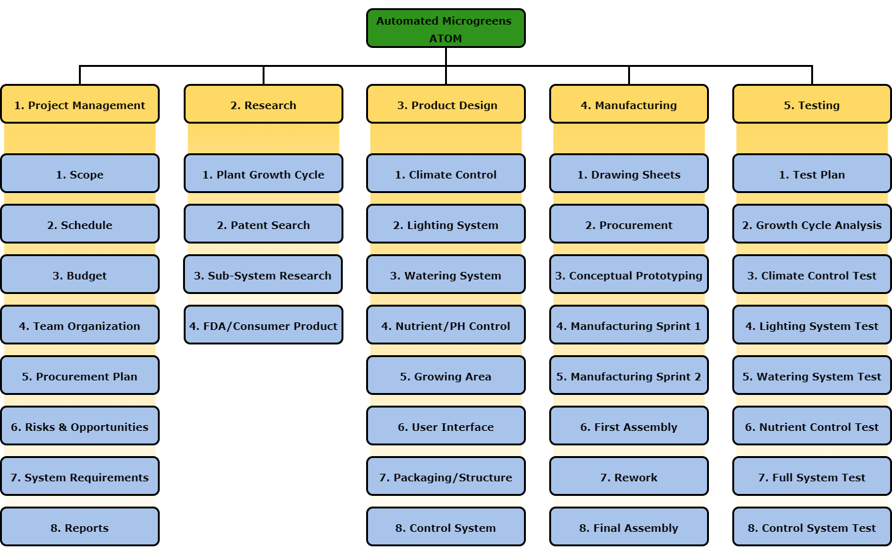
Scope

Slide 5
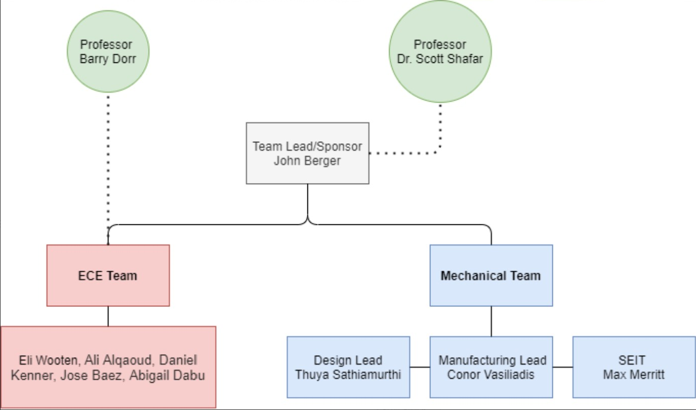
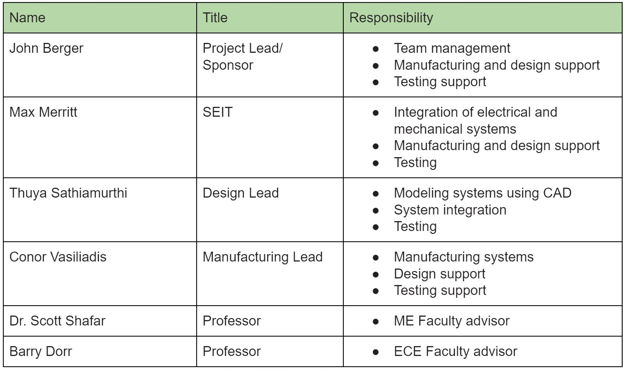
Team Organization Structure

Slide 6
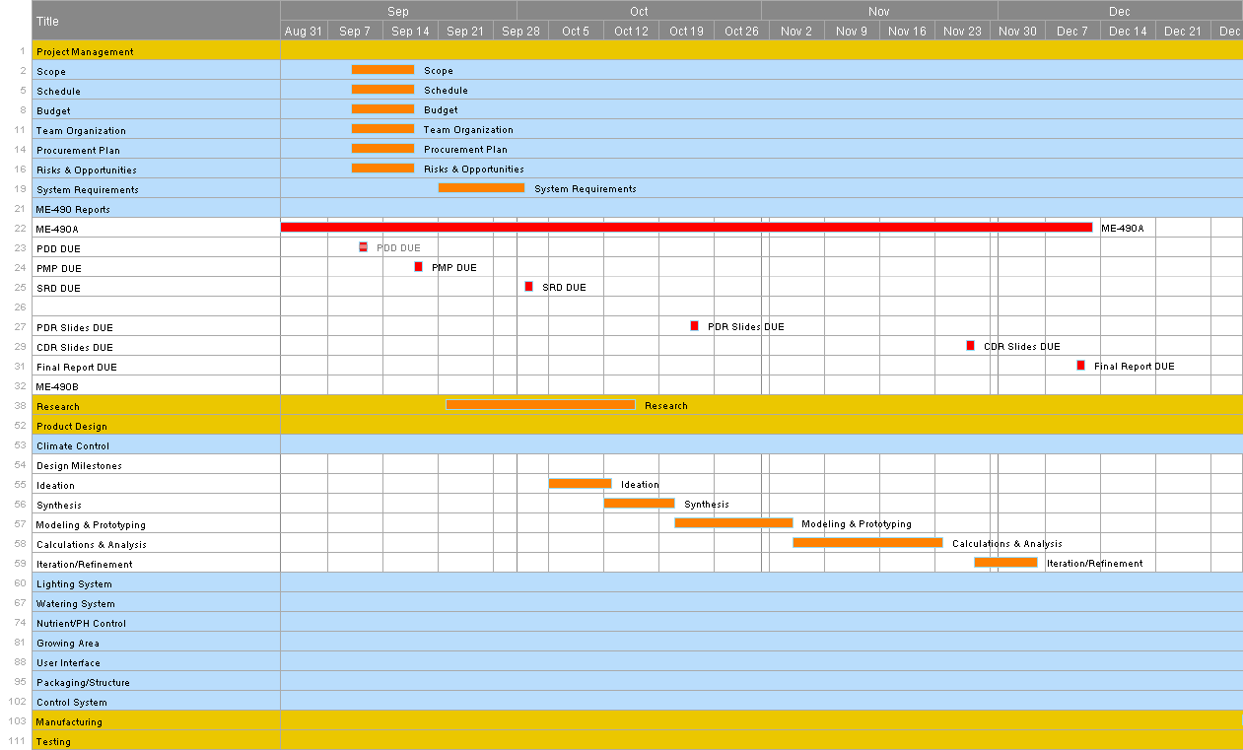
Schedule

Slide 7
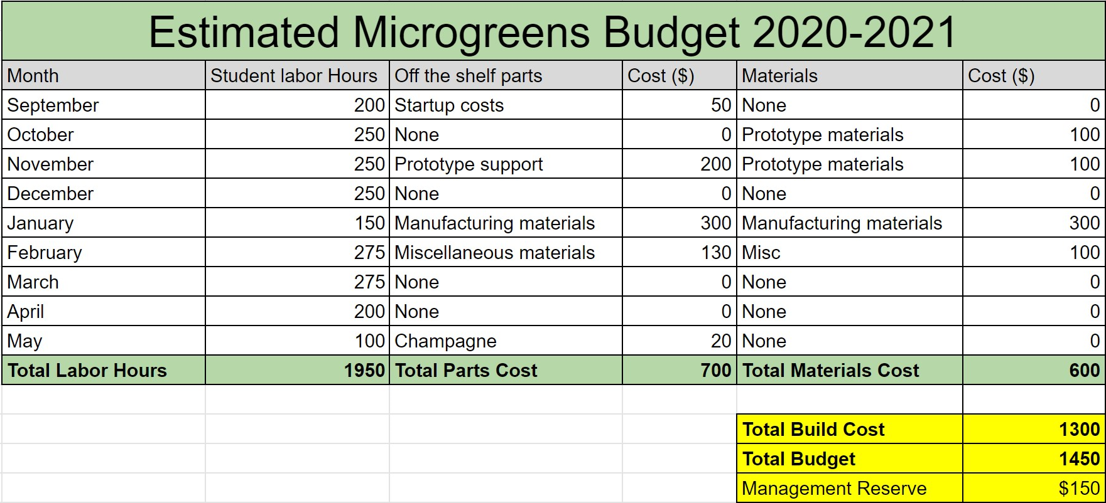
Budget

Slide 8
List of Major Suppliers
List of our distributors | Purpose
Competitive Metals | Sheet metal/Stock
Industrial Metal Supply | Sheet metal/Stock
Consolidated Metals Inc | Sheet metal/Stock
McMaster Carr | Mechanical components
Grainger | Pneumatics and general tools
DigiKey | Electrical components
JLC PCB | PCBs
San Diego Hydroponics | Nutrients and seeds
Rieker Machine | Machine Shop
Notes:
Hi, my name is Thuya
I’m going to be going over the list of major suppliers.
Our sheet metal/stock will be supplied by competitive metals, industrial metal supply, and consolidated metals incorporated.
Gerneral mechanical componets will be supplied by McMaster because they have CAD files and drawings for all their parts.
Pnumatics and general tools will be supplied by grainger because they are located right on campus and are easily accessable
Electrical components will be supplied by Digikey
PCB manufactuing and assembly will be outsourced to JLC PCB
San Diego hydroponics will be providing out Nutrients and Seeds
Rieker Machie shop is our alternative to the machine shop at SDSU if there is another outbreak

Slide 9
Risk Management - Risk List
Number | Risk Statement | Level of Likelihood | Level of Consequence | Mitigation Method
1 | If the SDSU machine shop remains closed due to the coronavirus, we will have to outsource parts. | 3 | 4 | Work closely with faculty to follow COVID-19 regulations and keep shop operational.
2 | If we have to outsource parts, cost will dramatically increase, possibly causing the project to be over our initial budget. | 3 | 3 | Try to get a quote far in advance, possible discount for student teams.
3 | If a part from outsourcing does not meet our design specs, it will have to be returned, delaying our current schedule. | 1 | 4 | Ensure drawings are clearly displayed to enhance clarity. Order parts ahead of schedule to minimize potential impact.
4 | If communication may suffer due to the virtual environment,this will lead to errors that compromise the design. | 1 | 4 | Regular online video meetings with clear work breakdown structure will ensure all team members are on the same page.
5 | If a team member contracts coronavirus, the project may be put behind schedule due to loss in performance. | 2 | 2 | Team members will follow Federal and SDSU regulations/advice in staying healthy.
6 | If a part breaks, we will have to reorder/remake it, putting us behind schedule and adding to the overall cost. | 2 | 2 | Will manufacture several copies of at-risk parts.
7 | If lack of accountability in the virtual environment leads to loss of performance, this will put the project behind schedule. | 1 | 3 | Use of “Smartsheet” application will keep log of all tasks, including who is responsible and due date of listed tasks.
8 | If an infectious team member spreads coronavirus to teammates, this will dramatically decrease performance which will cause the project to be behind schedule. (Note: only if team decides to meet in person) | 1 | 3 | Team members will follow Federal and SDSU regulations/advice in staying healthy.
9 | If water in our system leaks, possibly compromising electronics and requiring us to reorder parts. | 1 | 2 | Will test the water system outside of the unit, with no electronics installed.

Slide 10
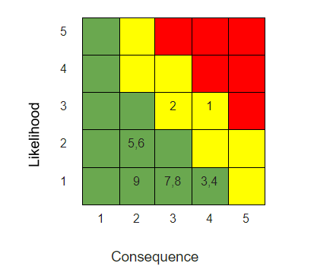
Risk Management - Risk Cube

Slide 11
Summary
“Design, build, and test an automated microgreens growing environment”
Key Points:
Integrated ECE team into team organizational structure
Established project management tools including: WBS, IMS and risk management
Project accepted into Zip Launchpad
Plan to create rapid testing and prototyping for the fall semester
Notes:
In conclusion, the purpose of our project is to design build and test an automated microgreens growing environment.
To do this, we have integrated an ECE team into our own team organizational structure
We have also been using project management tools such as the work breakdown structure, integrated master schedule, and the risk management charts to be a more efficient team
Recently we have been accepted into Zip Launchpad, which is great news
And finally, we are going to spend this semester rapid prototyping and testing

